Slide 1

The Machine Learning Process
Q & A
Dr. Reza Dibaj

Slide 2
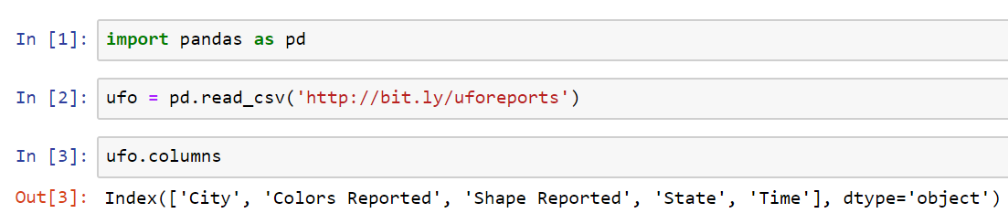
Question 1
Q: What if we want to read only two columns from the dataset to create our DataFrame?
R: 1st, let’s pull out a sample dataset as follows and see its columns.
Notes:
import pandas as pd
ufo = pd.read_csv('http://bit.ly/uforeports’)
ufo.columns

Slide 3
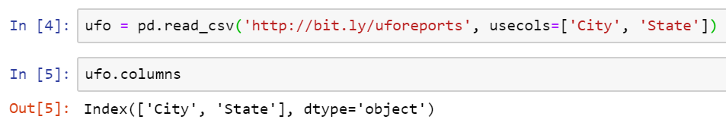
Question 1
R: When we read a csv file, we can specify the column names, using the usecols parameter as follows:
Notes:
ufo = pd.read_csv('http://bit.ly/uforeports', usecols=['City', 'State'])
ufo.columns

Slide 4
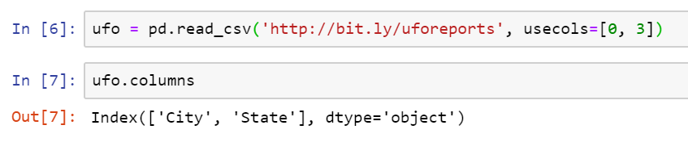
Question 1
R: Moreover, we can reference the columns by their positions as follows:
Notes:
ufo = pd.read_csv('http://bit.ly/uforeports', usecols=[0, 3])
ufo.columns

Slide 5
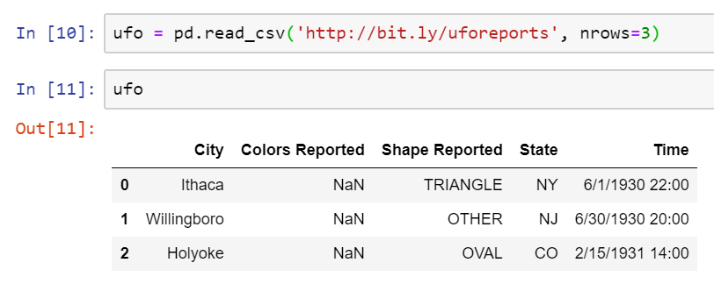
Question 2
Q: How can we speed up reading from a csv file?
R: We can simply limit reading the dataset by explicitly mentioning the number of rows to retrieve. This could drastically save the time when we want to have a general idea about the dataset, and the dataset is quite large.
Notes:
ufo = pd.read_csv('http://bit.ly/uforeports', nrows=3)
ufo

Slide 6
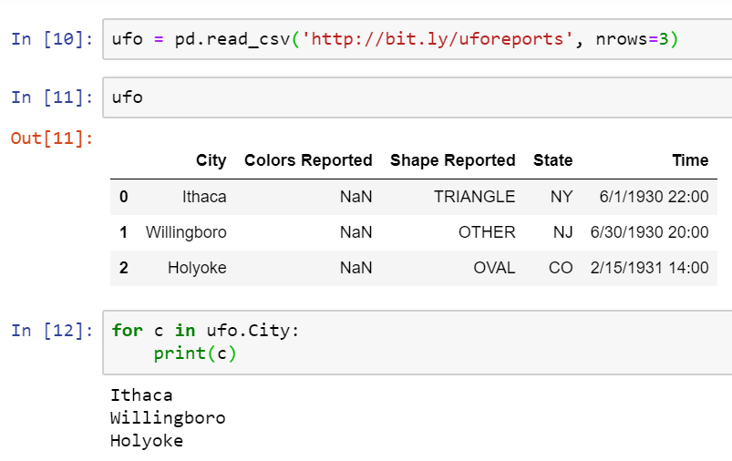
Question 3
Q: How can we iterate through a DataFrame and Series?
R: Simply, pandas series can be iterated like Python lists , so we can use for loop to iterate through a Series as follows:
Notes:
for c in ufo.City:
print(c)

Slide 7
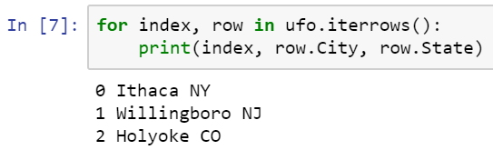
Question 3
R: For iterating through a DataFrame, pandas has a specific method that we can be used as follows:
Notes:
for index, row in ufo.iterrows():
print(index, row.City, row.State)

Slide 8
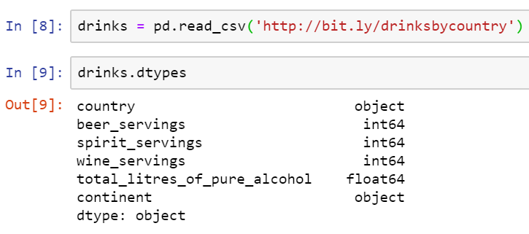
Question 4
Q: What is the best way to drop every non-numeric column from a DataFrame?
R: First, let’s pull up a different dataset of alcohol consumption as follows:
Notes:
drinks = pd.read_csv('http://bit.ly/drinksbycountry’)
drinks.dtypes

Slide 9
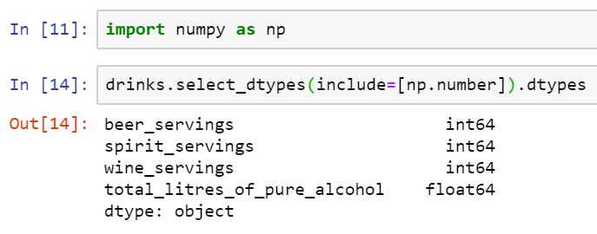
Question 4
R: Imagine that we want to delete the two object data type columns. First, we need to import numpy library.
Then, we select only the columns which their types are numeric as follows:
Notes:
import numpy as np
drinks.select_dtypes(include=[np.number])
drinks.select_dtypes(include=[np.number]).dtypes

Slide 10
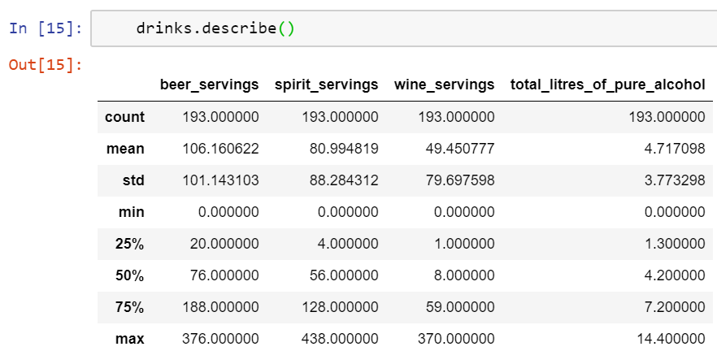
Question 5
Q: Where should we use [] and where shouldn’t we?
e.g. Why → movies.describe(include = [‘something’])
and not → movies.describe(include = ‘something’)
R: First, let’s use the current DF that we have and use the describe method.
Notes:
drinks.describe()

Slide 11
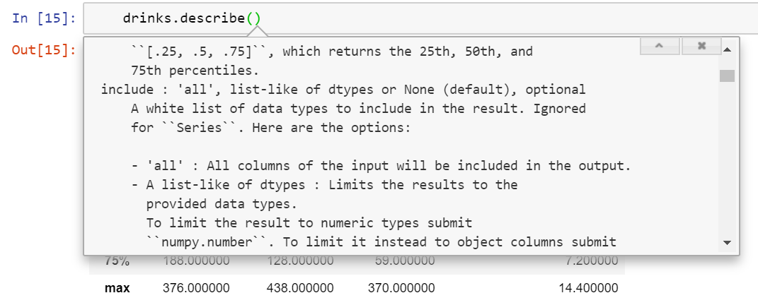
Question 5
R: Simply, we click inside the parentheses and press Shift+Tab 3 times, then we read the instruction for include…
So, if we want to include all we type include: ‘all’, and when it comes to list of items (any list, even if it contains only one element), we should use brackets.
Notes:
drinks.describe()

Slide 12
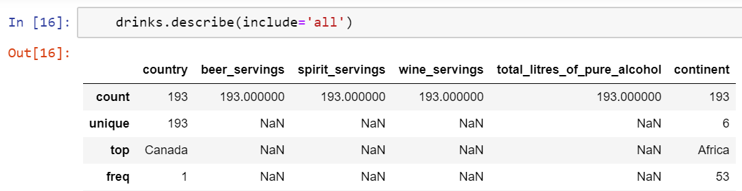
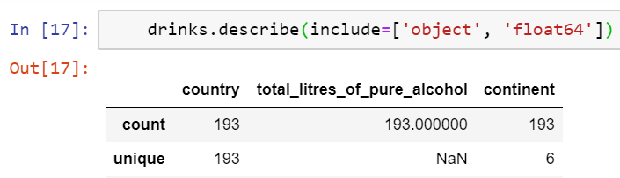
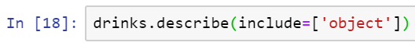
Question 5
R: Here are both examples:
Notes:
drinks.describe(include='all')

Slide 13

Thank you
Question?
To be
Not to be

